Slide 1
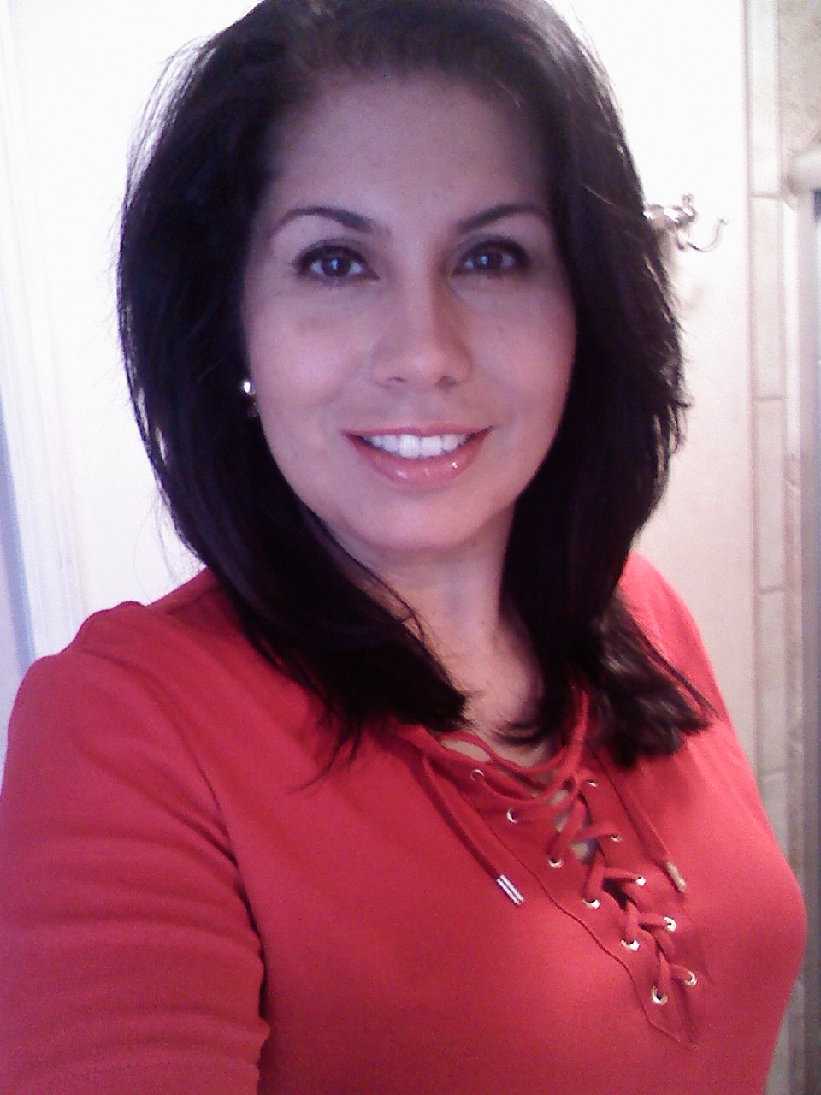
“Originality is a by-product of sincerity” ~Marianne Moore
My Life
Sarah Wolfe Escamilla

Slide 2
My Life…
Born and raised in Piqua, Ohio
Lived in El Paso, Texas and currently resides in Anthony, New Mexico
German and Hispanic descent
Mother of three, two who have health impairments
Self-advocate for those who are in the special needs realm
Avid reader and bibliophile
Exercise enthusiast
Education
Attended Edison State Community College, majored in Industrial Management then transferred to Doña Ana Community College, majored in Library Technology
Meritorious graduate ’07
Currently attending New Mexico State University, a junior majoring in history
GPA 3.9

Slide 3
Paragon Learning Style
Sarah
Extrovert
Feeler
Perceiver
Intuitive

Slide 4
PLSI con’t.
Warmly enthusiastic
High spirited
Ingenious
Imaginative
Able to do almost anything that interest them
Quick with a solution for any difficulty
Ready to help anyone with a problem
Often rely on their ability to improvise instead of preparing in advance
Can usually find compelling reasons for whatever they want

Slide 5
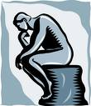
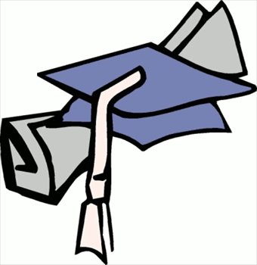
Professional goals
Graduate with a Bachelor of Arts-History
Take the state Teaching Certificate in order to obtain employment while continuing my education
Apply at community colleges which offer non traditional hours in order to balance work and school
Enroll in a Masters program for Librarians
“It takes courage to grow up And become who you really are”
~ E. E. Cummings

